Slide 1

Module 6: Abstract Data Types and Lists

Slide 2
Abstraction
Abstraction is one of the most powerful ideas in computer science. It separates the what from the how.
Abstraction provides modularity.
Classes are the Python representation for “Abstract Data Types,” (ADT) a very useful notion in any programming language.
An ADT involves both data and operations on that data.
(https://www.cse.iitd.ac.in/~pkalra/csl101/Python-ADT.pdf)

Slide 3
Abstract Data Types (ADT): Defining ‘What’ not ‘How’ https://www.alpharithms.com/abstract-data-types-adt-495117/
Abstract Data Types (ADT) are high-level abstractions characterized by a set of objects and related operations. ADTs do not define implementation guidance
Define what is getting done not how it is getting done
Operations are only defined by inputs and outputs
ADT common operations could be:
(these are by no means an exhaustive list)
Constructor: initializes a new instance of an ADT
Transformer: changes the state (value) of an ADT (aka mutator)
Observer: allows viewing of ADT values (no changes). aka accessor
Destructor: clears the state of an ADT before releasing memory
Iterator: process all components of an ADT, one at a time

Slide 4
Stack ADT A stack is a LIFO (last in, first out) list with the following operations:
Stack() creates a new stack that is empty. It needs no parameters and returns an empty stack.
push(item) adds a new item to the top of the stack. It needs the item and returns nothing.
pop() removes the top item from the stack. It needs no parameters and returns the item. The stack is modified.
top() returns the top item from the stack but does not remove it. It needs no parameters. The stack is not modified.
isEmpty() tests to see whether the stack is empty. It needs no parameters and returns a boolean value.
size() returns the number of items on the stack. It needs no parameters and returns an integer.

Slide 5
Stack ADT as a Class
class Stack:
def __init__(self):
self.items = []
def IsEmpty(self):
return self.items == []
def push(self,item):
self.items.append(item)
def pop(self):
return self.items.pop()
def top(self):
return self.items[len(self.items)-1]
def size(self):
return len(self.items)

Slide 6
Queue ADT A Queue is a FIFO (first in, first out) list with the following operations:
Queue() creates a new queue that is empty. It needs no parameters and returns an empty queue.
Enqueue(item) adds a new item to the rear of the queue. It needs the item and returns nothing.
Dequeue() removes the item from the front of the queue. It needs no parameters and returns the item. The queue is modified.
Front() returns the front item from the queue but does not remove it. It needs no parameters. The queue is not modified.
isEmpty() tests to see whether the queue is empty. It needs no parameters and returns a boolean value.
size() returns the number of items on the queue. It needs no parameters and returns an integer.

Slide 7
Queue ADT as a Class
Class Queue:
def __init__(self):
self.items = []
def IsEmpty(self):
return self.items == []
def enqueue(self,item):
self.items.append(item)
def dequeue(self):
return self.items.pop(0)
def front(self):
return self.items[len(self.items)-1]
def size(self):
return len(self.items)

Slide 8
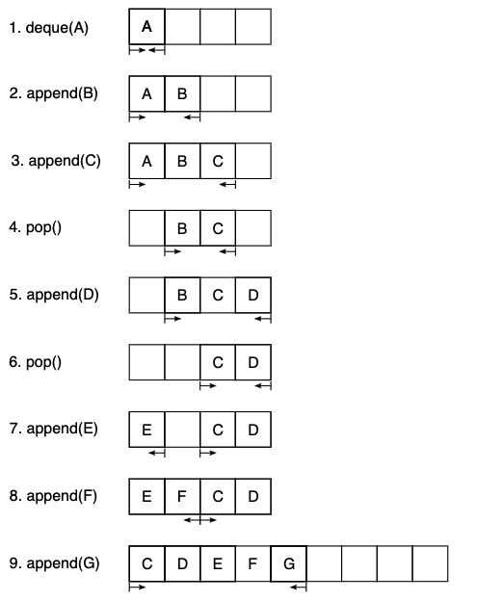
Ring buffers https://object-oriented-python.github.io/5_abstract_data_types.html
How might one go about implementing a deque?
A dynamic array allows values to be appended with O(1)O(1) complexity, but doesn’t offer an efficient mechanism for prepending values.
The solution is to use a dynamic array, but to logically join up its ends, so that the first position in the buffer follows on from the last.
Only in the case where all positions in the buffer are full will the buffer be reallocated.
This data structure is called a ring buffer.

Slide 9
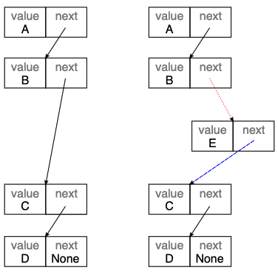
Linked Lists https://object-oriented-python.github.io/5_abstract_data_types.html
One disadvantage of a deque (and hence of a stack or queue) is that inserting an object into the middle of the sequence is often an O(n)O(n) operation, because on average half of the items in the sequence need to be shuffled to make space.
A linked list provides a mechanism for avoiding this.
A singly linked list is a collection of links. Each link contains a reference to a data item and a reference to the next link.
Diagram of a linked list.

Slide 10
Simple Singly Linked List Implementation
class Link:
def __init__(self, value, next=None):
self.value = value
self.next = next
def insert(self, link):
'''Insert a new link after the current one.’’’
link.next = self.next
self.next = link

Slide 11
Other abstract data types
Set
A set is an unordered collection of objects with the property that objects that compare equal can only occur once in the set. Python provides the set built in class as an implementation.
dictionary or map
A generalized function in which unique (up to equality) keys are mapped to arbitrary values. The Python dict type is an implementation.
Graph
A general relation between a set and itself defined by a set of vertices and a set of edges, where each edge connects exactly two vertices. Graphs can be used to describe very general relationships among data.
Tree
A particular sort of graph in which edges have a direction (a from and a to node), and each node is the origin of at most one edge. Trees can be used to describe many types of structured relationship.

Slide 12
Abstract Data Types (ADTs)
ADTs are high-level concepts that encapsulate a Type or Class and dictate a set of operations or procedures through which data can be manipulated.
The ability to define the what of implementation and not the how allows designers to focus on the big picture rather than be distracted by lower-level details.
ADTs can be a bit heady in definition but in practice, they are almost beautiful in the simplicity through which they direct such immense expression.
The Queue, Stack, List, and Tree are found throughout the world of Computer Science and Software Engineering as countless different implementations—yet all find form from the same ADTs.

Slide 13
Lists and other things in Python From the Edureka Python tutorial
Sequences
Sequence Operations
Types of sequences in Python
Lists
Tuples
Sets
Dictionaries

Slide 14
What are sequences?
Sequences are containers with items that are accessible by indexing or slicing
The built-in len function takes any container as an argument and returns the number of items in the container

Slide 15
Sequence Operations
Concatenation
Repetition
Membership Testing
Slicing
Indexing

Slide 16
Lists
The list is the most versatile datatype available in Python
It can be written as a list of comma-separated values (items) between square brackets
Items in a list need NOT be of the same type
Fruits = [‘Mango’,’Apple’,’Grapes’]
Operations
Append | List.append(elem)
Insert | List.insert(index, elem)
Extend | List.extend(list2)
Index | List.index(elem)
Remove | List.remove(elem)
Sort | List.sort()
Reverse | List.reverse()

Slide 17
Tuples
A tuple is a sequence of immutable Python objects
Tuples are sequences like lists except they cannot be changed and they use parenthesis
Fruits = (‘Mango’,’Apple’,’Grapes’)
Operations
Index | Tuple.index(elem)
Slicing | Tuple[range]
Concatenation | Tuple1 + Tuple2
Repetition | Tuple * x
Count | Tuple.count(elem)

Slide 18
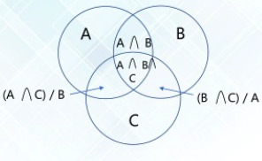
Sets
A set contains an unordered collection of unique and immutable objects
A Python implementation of the sets as they are known from mathematics
Fruits = (‘Mango’,’Apple’,’Grapes’)
Slicing | Difference
Add Element | Discard
Clear | Remove
Copy | Intersection

Slide 19
Dictionaries
Dictionaries are used to store data values in key:value pairs.
A dictionary is a collection which is ordered*, changeable and do not allow duplicates.
thisdict = { "brand": "Ford", "model": "Mustang", "year": 1964 } print(thisdict["brand"])
Dictionaries are changeable, meaning that we can change, add or remove items after the dictionary has been created.
Dictionaries cannot have two items with the same key: Duplicate values will overwrite existing values
The values in dictionary items can be of any data type:
thisdict = { "brand": "Ford", "electric": False, "year": 1964, "colors": ["red", "white", "blue"] }

Slide 20
Python - Access Dictionary Items
Accessing Items
You can access the items of a dictionary by referring to its key name, inside square brackets:
thisdict = { "brand": "Ford", "model": "Mustang", "year": 1964 } x = thisdict["model"]
OR
x = thisdict.get("model")
Add a new item to the original dictionary, and see that the keys list gets updated as well:
car["color"] = "white”
Make a change in the original dictionary
car["year"] = 2020
To determine if a specified key is present in a dictionary use the in keyword:
if "model" in thisdict: print("Yes”)

Slide 21
Changing contents of a dictionary and looping
Update the "year" of the car by using the update() method:
thisdict.update({"year": 2020})
thisdict.update({"color": "red"})
The pop() method removes the item with the specified key name
thisdict.pop("model") also del thisdict["model"]
The clear() method empties the dictionary
thisdict.clear()
Print all key names in the dictionary, one by one and Print all values in the dictionary, one by one
for x in thisdict: print(x)
print(thisdict[x])
You can also use the values() method to return values of a dictionary:
for x in thisdict.values(): print(x)
You can use the keys() method to return the keys of a dictionary:
for x in thisdict.keys(): print(x)
Make a copy of a dictionary
mydict = thisdict.copy() also
mydict = dict(thisdict)

Slide 22
Python Dictionary Methods https://www.w3schools.com/python/python_dictionaries_methods.asp
Method | Description
clear() | Removes all the elements from the dictionary
copy() | Returns a copy of the dictionary
fromkeys() | Returns a dictionary with the specified keys and value
get() | Returns the value of the specified key
items() | Returns a list containing a tuple for each key value pair
keys() | Returns a list containing the dictionary's keys
pop() | Removes the element with the specified key
popitem() | Removes the last inserted key-value pair
setdefault() | Returns the value of the specified key. If the key does not exist: insert the key, with the specified value
update() | Updates the dictionary with the specified key-value pairs
values() | Returns a list of all the values in the dictionary

